Slide 1



SOFTWARE DEVELOPMENT PROFESSIONAL PROGRAM
Learning to Love Your Terminal

Slide 2





Learning to Love Your Terminal
Learning Objectives
View the contents of a directory using ls
Create a directory using mkdir
Enter a directory using cd
Open a directory using code

Slide 3
Learning to Love Your Terminal
Terminal
A computer program
That allows us to type instructions and is used by programmers for many development tasks.
Notes:
The terminal is often referred to as command line interface [CLI] or console.

Slide 4

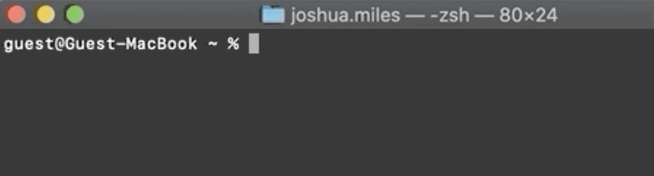
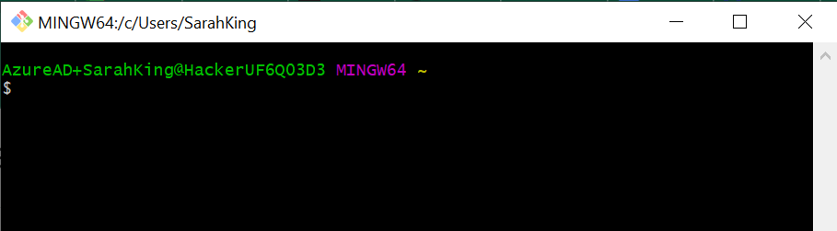
Learning to Love Your Terminal
Why Does Mine Look Different?
There are different terminal programs that allow you to access a command line shell for your computer.
Examples include Git Bash for Windows and Terminal for Mac and Linux.
Zshell on Mac Terminal
There are also different types of command line shells, most notably Bash and ZShell.
While these windows might look different, most of their commands and functionalities are the same; the commands we are using in this lecture are the same.
Bash shell on Git Bash (git for windows)
Notes:
Windows users will likely be using Git Bash,
MacOS users on Catalina or newer will likely be using Zsh (that is what comes default on Terminal),
Linux users and older MacOS userswill likey be using Bash.
* OhMyZsh is a very common framework used to manage Zsh configurations and change the look of the terminal.
<< let learners know that despite the aesthetic changes, the functionality stays the same.>>

Slide 5


Learning to Love Your Terminal
Benefits of Using the Terminal
Utilize powerful developer tools.
Run developer-specific software.
Be like Neo in the Matrix in front of friends and family.
Notes:
Terminals allow us to run many programs, made just for developers,
which don't have a GUI (Graphical User Interface).

Slide 6
Learning to Love Your Terminal
List: ls
Type ls
Hit Enter or Return.
The computer will list files and directories in the current directory.

Slide 7

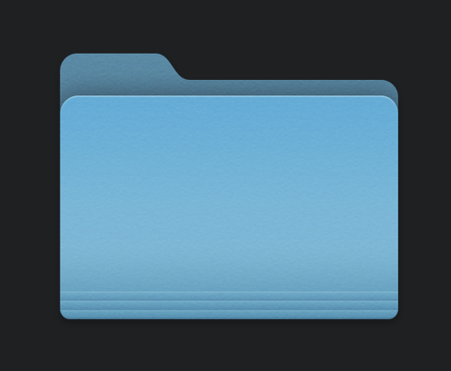
Learning to Love Your Terminal
What Is a Directory?
A collection of files and other directories.
Also known as a folder.
The same files and folders are available to you in Finder or File Explorer.

Slide 8

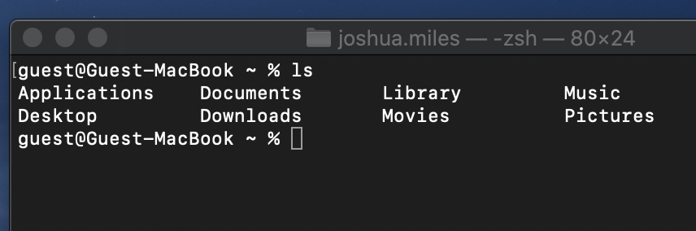
Learning to Love Your Terminal
Example: ls
Open the terminal.
Run ls.
The computer displays the files and directories in your home directory.
The home directory is what you see when you open File Explorer to view folders such as Documents, Pictures, Desktop, etc.
Notes:
For example, typing 'ls' right after opening the terminal displays the contents of your home directory
(the one that contains your Desktop, Documents, and Pictures folders.)

Slide 9
Learning to Love Your Terminal
Change Directory: cd
Type cd directory-name
Hit Enter or Return.
The computer will change your current directory.
This is similar to opening the folder from your terminal.

Slide 10
Learning to Love Your Terminal
Example: cd
Run ls.
Run cd Desktop.
Run ls again.
The computer displays a different list because we have opened a different directory.

Slide 11

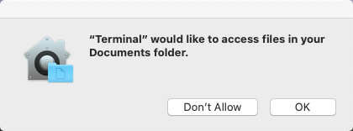
Learning to Love Your Terminal
Access Warning
Notes:
Occassionally, you will see a warning or error message when you access a folder in your terminal for the first time.
As long you are the one controlling your terminal, it should be fine to simply click OK and dismiss the warning.

Slide 12
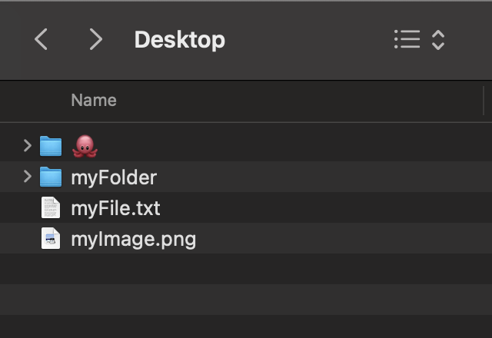
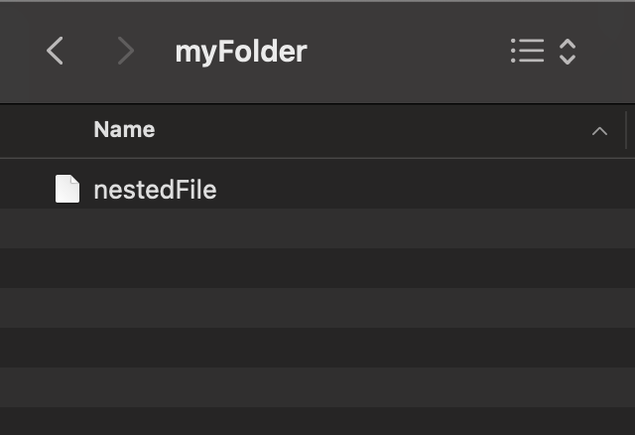
Learning to Love Your Terminal
Going Back
cd Desktop
cd myFolder
cd ..
Notes:
When you need to go back to the parent of the current directory, you can use ..

Slide 13
Learning to Love Your Terminal
Question: ls
What would ls display if we ran it while in the desktop?
A) myFile.txt myFolder myImage.png 🐙
B) Desktop
C) Nothing
D) An error

Slide 14
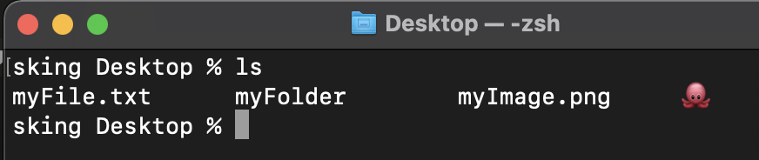
Learning to Love Your Terminal
Answer: ls
What would ls display if we ran it while in the desktop?
✅ myFile.txt myFolder myImage.png 🐙
🚫 Desktop
🚫 Nothing.
🚫 An error.

Slide 15
Learning to Love Your Terminal
Make Directory: mkdir
Type mkdir directory-name
Hit Enter or Return.
The computer will create a directory inside the current directory with the name you provided.

Slide 16
Learning to Love Your Terminal
Example: mkdir
Run ls
Run mkdir my-first-project
Run ls again.
The computer displays a list of files and directories, including the new one we just created.

Slide 17
Learning to Love Your Terminal
Question: Opening Folders
How would I go into the last directory we created?
A) cd
B) mkdir my-first-project
C) cd my-first-project
D) ls

Slide 18
Learning to Love Your Terminal
Answer: Opening Folders
How would I go into the last directory we created?
🚫 cd
🚫 mkdir my-first-project
✅ cd my-first-project
🚫 ls

Slide 19

Learning to Love Your Terminal
Opening Other Programs
The terminal can be used to open other applications.
We'll use VSCode as an example.

Slide 20
Learning to Love Your Terminal
Terminal Command: code .
Type code .
Hit Enter or Return.
The computer will open the current directory in VSCode.
Note: the . refers to the current directory, and will be used as such in other commands we will learn later.

Slide 21
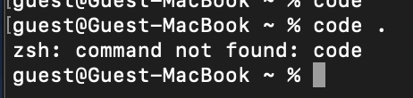
Learning to Love Your Terminal
Command Not Found: Code
Open VSCode.
Press Command + Shift + P.
Type Install Code.
Hit Enter.
Notes:
Occassionally, you may see this error on a Mac.
When you do, you can follow these steps to use VSCode to add the 'code' command to your terminal.

Slide 22
Learning to Love Your Terminal
Summary
What We've Covered
Key Terminal Commands
ls: lists directory contents.
mkdir: makes a new directory.
cd: changes the active directory.
code: opens VSCode.
Let's use the developer tools we've just learned to create your first webpage!

